Slide 1
Clk
D
Q
D
Clk
Q
Clk
D
Q
Write
Write
D
Clk
Q

Slide 2
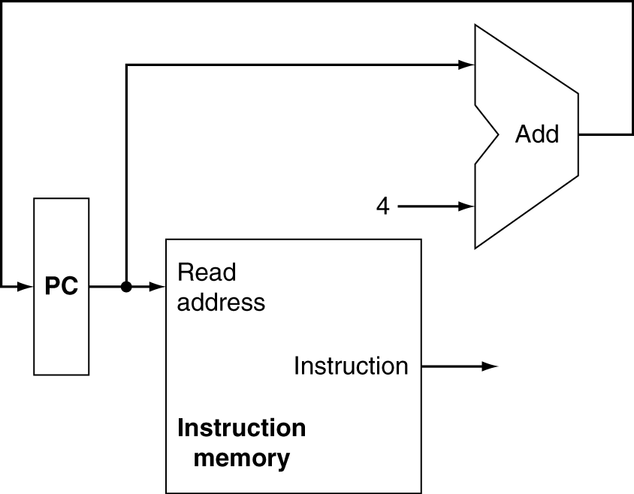
Increment by 4 for next instruction
32-bit register

Slide 3
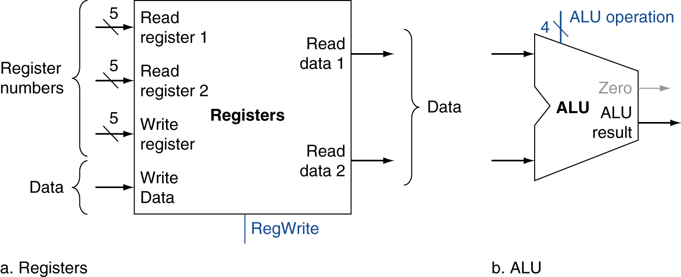

Slide 4
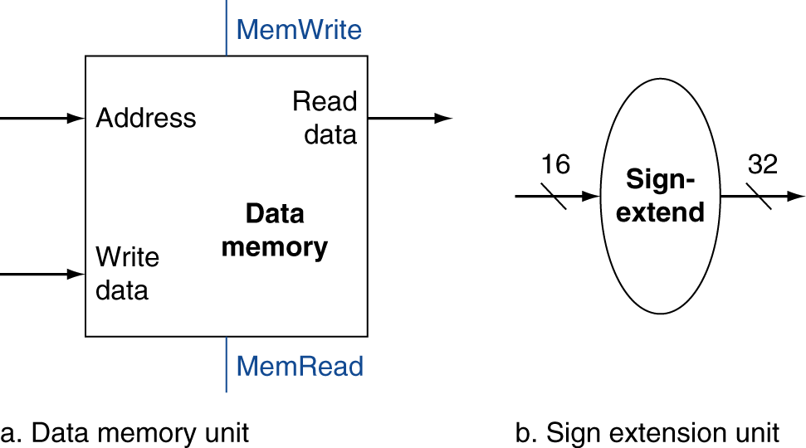

Slide 5
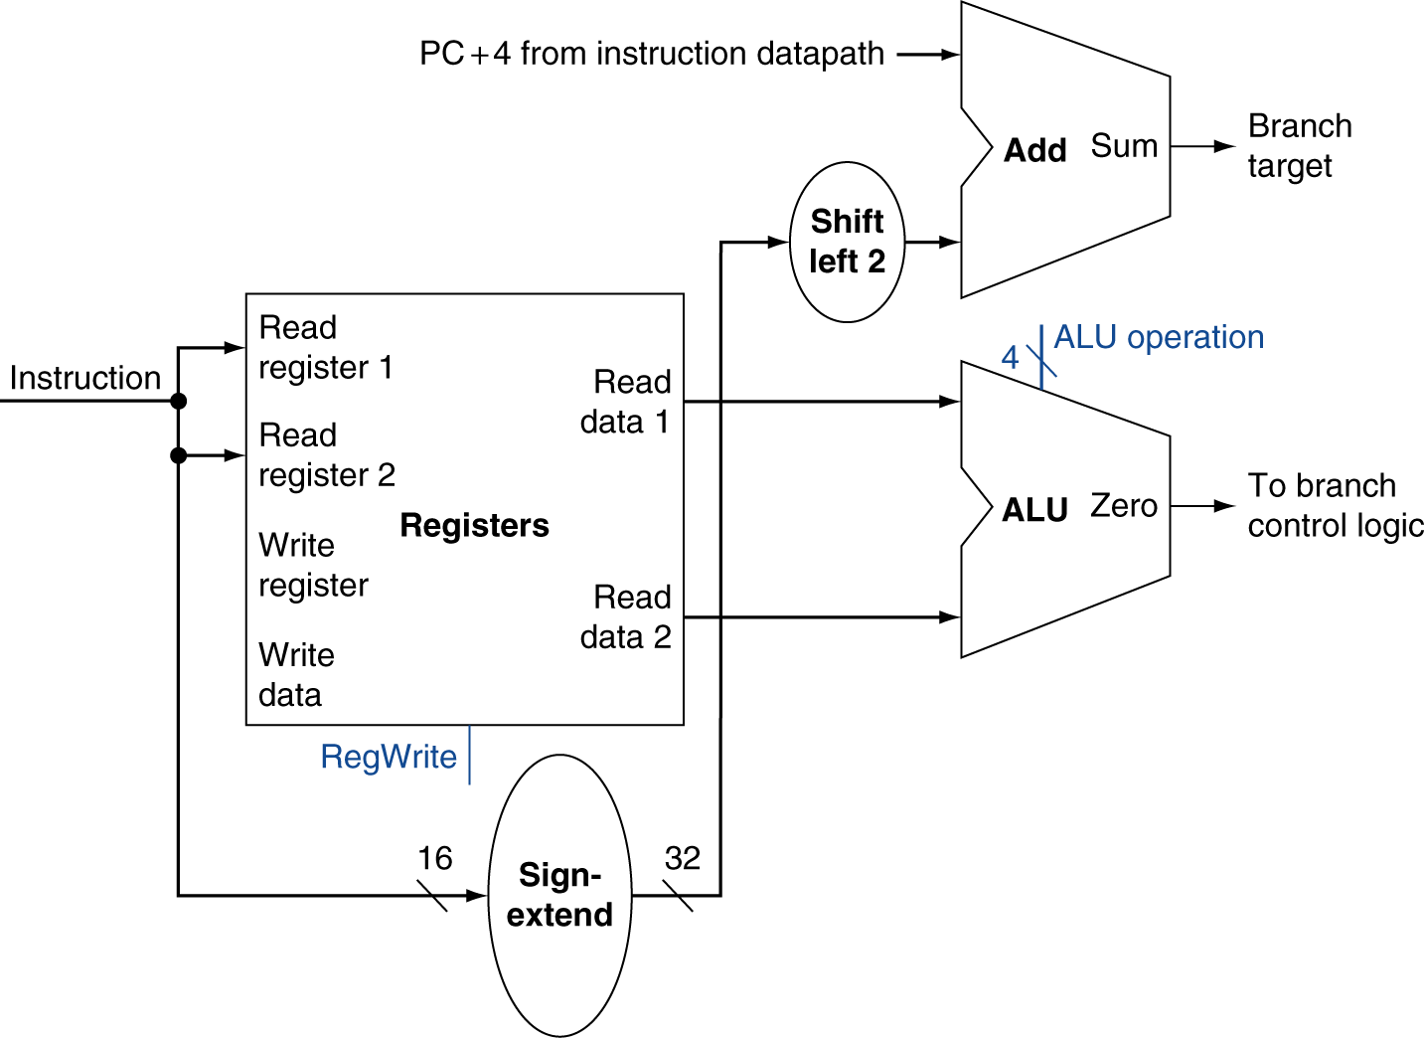
Just re-routes wires
Sign-bit wire replicated

Slide 6
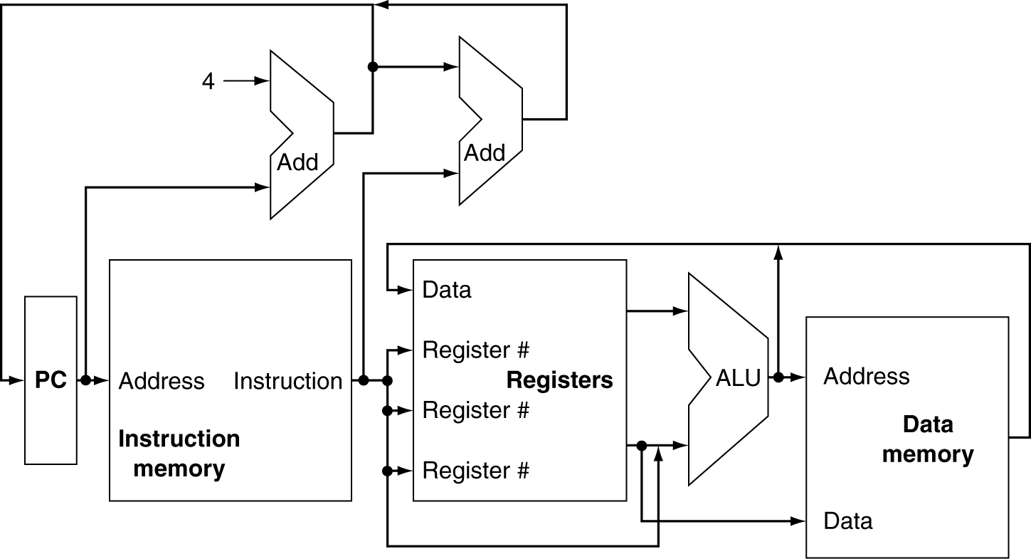
Can’t just join wires together
Use multiplexers

Slide 7
